Slide 1
An_{alysis} O_{f} Va_{riance}
ANOVA Time!

Slide 2
What is ANOVA?
ANOVA stands for the analysis of variance.

Slide 3
What is ANOVA?
One or more independent variables
With different levels/conditions (groups or measurements)
Analyzing differences in means
On a continuous dependent variable.

Slide 4
Why ANOVA?
You can use t-tests to analyze two groups or two time measurements from the same people.
However, when you use more than two groups or times, you increase the chance of a Type 1 error (rejecting when you shouldn’t) for each t-test you have to run.

Slide 5
Why ANOVA?
Therefore, you use an ANOVA to cover the chance of that error.
However, ANOVAs have the disadvantage of involving extra steps or post hoc tests.

Slide 6
Parts of ANOVAs
IV – independent variable.
This variable has to be a dichotomous variable. You can put people into groups based on any category (gender, handedness) or your experimental manipulation (instructions versus no instructions).

Slide 7
Parts of ANOVAs
DV – dependent variable. The dependent variable needs to be a continuous variable or another type of analysis might work better (see log regression).
Your dependent variable should be the measurement you took in your study or what information you are expecting to see changed over groups.

Slide 8
Parts of ANOVAs
Levels versus conditions:
Levels are the different groups within an IV.
Conditions are the combinations of different levels.

Slide 9
Parts of ANOVAs
IV: Gender
Levels: Male, Female
Conditions would be the same because you only have one variable.
IV: Gender, Handedness
Levels: Male, Female, Left, Right
Conditions: Male Left, Male Right, Female Left, Female Right

Slide 10
Types of ANOVA
One-way versus two-way:
The word “way” just means number of independent variables. So a one-way ANOVA has one IV, while a two-way has two IVs.

Slide 11
Types of ANOVAs
Between subjects / independent: ANOVA for independent measures where participants are in only one level/condition.
Repeated measures / dependent / within subjects: ANOVA for dependent measures where participants are in all levels/conditions.
Mixed designs: ANOVA for when you have two variables, one between subjects and one repeated measures.

Slide 12
Types of ANOVAs
For two or more way ANOVAs:
# X # (i.e. 2X4, 2X3) ANOVA: designates the number of levels for the multiple IVs in a two-way design.

Slide 13
Types of ANOVAs
If you say a 2X4 between subjects ANOVA, you mean:
I have two variables.
These variables are both between subjects.
One variable has two levels.
One variable has four levels.
Together there are eight conditions.

Slide 14
Types of ANOVAs
Whereas a 2X2X3 mixed ANOVA would be:
I have three variables.
Some are repeated, some are between subjects variables.
One variable has two levels.
One variable has two levels.
One variable has three levels.
There are twelve conditions.

Slide 15
Hypothesis Testing
ANOVA: First you run an ANOVA to determine the following:
Null hypothesis – level/condition means are not different.
Research hypothesis – level/conditions means are different.

Slide 16
Hypothesis Testing
Notice, this analysis does not tell you where group differences occur, just that groups are different.
If your overall test is significant, you then run a post hoc test (different types are discussed below) to determine how groups are different.

Slide 17
Hypothesis Testing
Post Hoc Tests: depending on the type of test, you will have to run several tests to determine how levels/conditions are different, usually by comparing level/condition means pairwise (two at a time).

Slide 18
Hypothesis Testing
Types of post hocs:
A priori – or planned comparisons: means that you knew before you started the experiment what group means you wanted to compare.
A posteriori – all comparisons: after the fact you decided to do these comparisons or you decided to do all pairwise combinations.
We are mostly going to discuss posteriori tests because they are the most common.

Slide 19
Hypothesis Testing
Post hoc TEST: The actual statistical test you use to determine group differences.
Must match the type of analysis you are using.
Between subjects = independent t-test.
Repeated measures = dependent t-test.

Slide 20
Hypothesis Testing
Post hoc CORRECTION:
You can still run into the problem of increasing Type 1 error rate if you run all pairwise combinations (or just have a lot of tests). We will discuss the most common solutions for Type 1 error control, given the type of test you are running.

Slide 21
Hypothesis Testing
What do the corrections do? Control type 1 error rate by making it harder for you to find a significant difference.

Slide 22
Hypothesis Testing
However, that’s not obvious on the output, because it automatically recalculates the p-values based on that adjustment.
That auto recalculation is a good thing! It makes it easy to remember the rule for if you should say it’s significant or not.

Slide 23
Hypothesis Testing
There are many types of corrections – we are going to do Bonferroni for simplicity.

Slide 24
F Distribution
F-ratios:
In this chapter, we introduce a new statistical distribution and letter, F.
We discussed previously the z and t distributions, which are related to the F distribution.

Slide 25
F Distribution
The F distribution is the t distribution squared, so there are no negative cut off scores or F-values.
With the t distribution, we had one degree of freedom (df) value to use to look up cut off scores or report for our results sections.

Slide 26
F Distribution
With F, we have two df value to report:
Model (numerator)
Error (denominator).

Slide 27
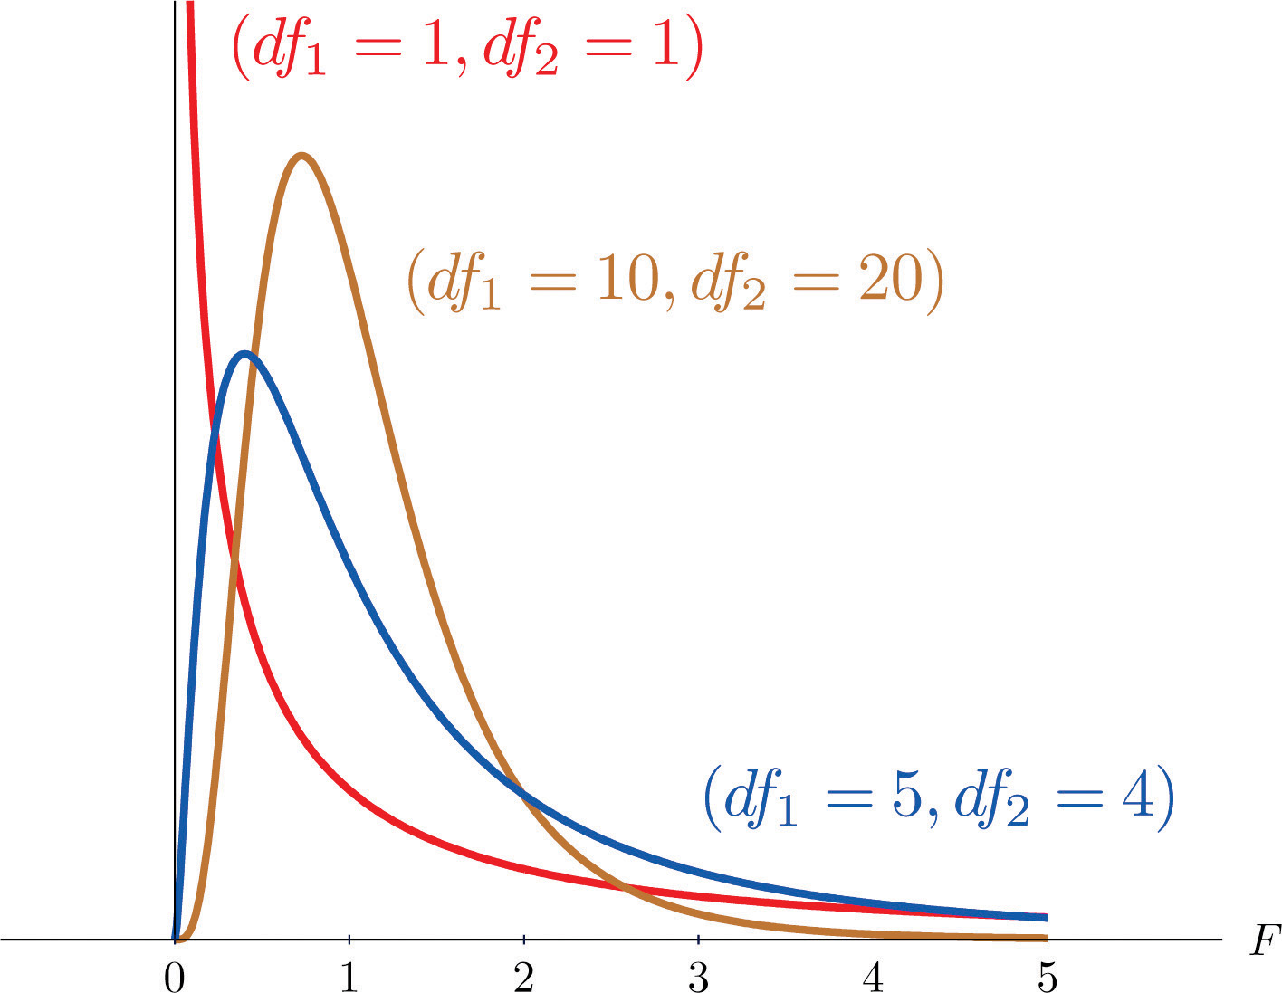

Slide 28
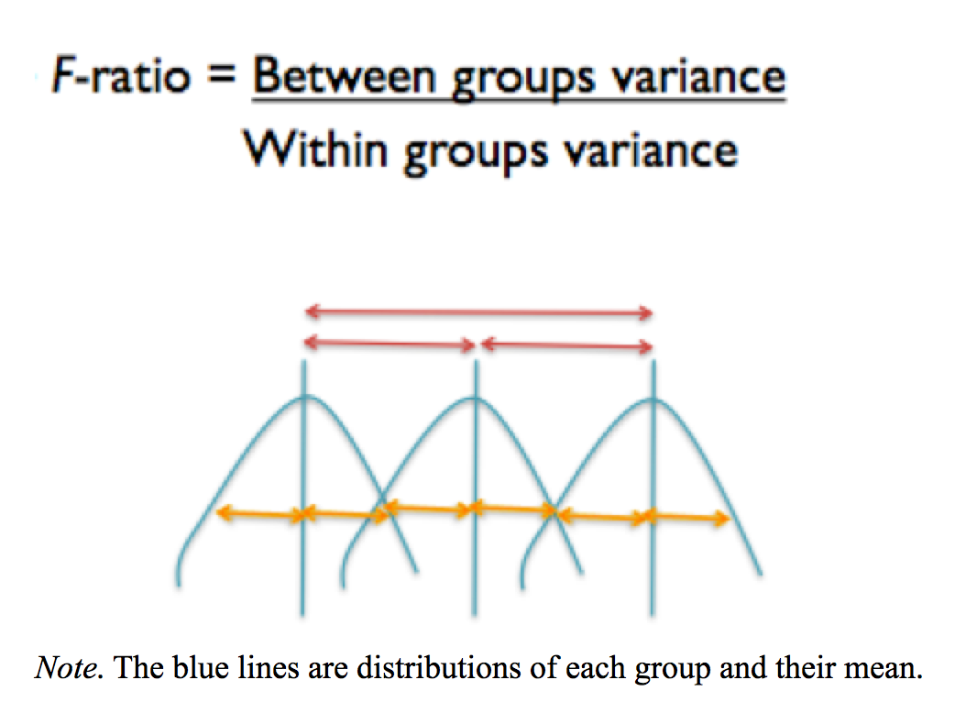

Slide 29
F Ratio
Model variance – This variance is the noted in red on the picture.
You are measuring an average distance between level/condition means and the grand mean.

Slide 30
F Ratio
You want this score to be LARGE because it is the effect that your experiment had on the means.
Small numbers indicate that the means are not very different (boo!), while large values indicate that at least one of the means is far apart from the rest.

Slide 31
F Ratio
Error variance – This variance is the error term in your experiment, noted in yellow on the picture.
This score is basically the average of group variances.

Slide 32
F Ratio
You want this score to be SMALL, which means that you measured your groups with precision and their scores do not vary widely.
Large numbers indicate a lot of error or that levels/conditions have a wide range of scores.
Small numbers indicate that you have scores that tightly cluster around their means.
Sometimes, this value is called individual differences.

Slide 33
F Ratios
Model df (numerator) = Number of levels/conditions – 1 (number of means for that variable)
Error df (denominator) = (Number of participants – 1) + (Number of participants – 1) + (Number of participants – 1) …
(mainly I want you to know it’s N-1 idea).

Slide 34
Effect Size
η² is effect size (eta squared) – the proportion of variance accounted for by the between groups variance (you want this to be big).

Slide 35
Effect Size
Numbers range from 0 – 1.
Small = .01
Medium = .09
Large = .25
Basically, how much variance is due to the IV and not the error variance.
NOTE: this value will be listed as ges on the output.

Slide 36
Power!
Download G*Power if you haven’t already!
For each type of ANOVA we will cover how to calculate power.
There is also a handy chart on blackboard that covers many designs we will go over.

Slide 37
Data Screening
Accuracy – same!
Missing – well, there’s only one DV that you could really fill in … so basically, you have to drop missing people.

Slide 38
Data Screening
Outliers – we’ve discussed Mahalanobis – but for that procedure to run, you have to have more than one continuous variable.
Which means that all between subjects only designs cannot use this procedure.
Therefore, we will talk about how to use z-scores to eliminate outliers.

Slide 39
Data Screening
Additivity:
With between subjects only designs, there is only one DV (continuous variable), so there’s nothing to check.
With repeated measures designs, there’s a new rule r < .999.
Why?

Slide 40
Data Screening
Normality – check!
Linearity – check!
Homogeneity/homoscedasticity – check!
Levene’s test
Sphericity – Mauchley’s test

Slide 41
R Stuff
We are going to do examples of the following:
One way between subjects
One way repeated measures
Two way between subjects only
Two way repeated measures only
Two way mixed

Slide 42
R Stuff
For each one, we will cover:
Power
Data screening
The ANOVA
Post Hocs
Effect sizes
Graphs
Write ups

Slide 43
R Stuff
You will want to install:
ez
ggplot2
How to run through examples?
Do it? (with the answers)
Example watch? (but no interruptions)

